Slide 1
A Deep Reinforcement Learning Approach for Global Routing
PhD Student: Haiguang Liao
Advisor: Levent Burak Kara (Mechanical Engineering Department)
Barnabas Poczos (Machine Learning Department)
Sep.06.2019

Slide 2
Statement of Contributions
-My role in this research:
literature review, algorithm design
majority of code implementation, results analysis
-Professors (Levent Burak Kara, Barnabas Poczos) gave suggestions and instructions throughout the research
- Collaborators:
Wentai Zhang (PhD student) helped with algorithm design and code implementation
Xuliang Dong (Master Student) helped with parametric study
1
Notes:
My role in this research consists of literature review, algorithm design, the majority of the code implementation, and results analysis. Professor Levent Burak Kara and Professor Barnabas gave suggestions throughout the process of this research.
For my collaborators:
Wentai helped with algorithm design and part of the code implementation.
Liang helped with parametric study.

Slide 3
Introduction
Global routing is a critical step in Integrated Circuits (IC) design
AMD Soc System
Application: X-Box, PlayStation
Visualized Routing Solutions in an IC design software
https://www.researchgate.net/figure/A-gcell-in-which-a-routing-blockage-occupies-90-of-the-capacity-If-two-tracks-are-used_fig1_242748131
2
https://www.tomshardware.com/news/amd-gonzalo-soc-xbox-scarlett-playstation-ps5,39039.html
Notes:
So first let me briefly introduce global routing. Global routing is a challenging stage in Integrated Circuits (or IC) design. Literally all electronic products containing chips (such as cellphone, laptop, play station, etc) require IC design. During global routing, resources for routing in a chip is allocated. The solution quality of Global Routing has a huge impact on the performance of designed chip. The figure on the right shows a congestion map based on routing solution of an IC chip.
Green color corresponds to less congested areas (that is there are less wires), while red areas corresponds to highly congested areas (that is there are lots of wires).

Slide 4
Introduction
Global routing can be formulated into a graph problem mathematically
Grid Graph G(V,E)
v_{i} – rectangular region of chip (Gcell)
e_{ij} – boundary between v_{i} and v_{j}
Goal: find wiring paths that connects the pins of each net in G(V,E)
Overflow (OF)
OF:1
Capacity =2
A
WL: 4
A
B
A
B
Wirelength (WL)
C
D
C
D
B
Circuits with Gcells
Grid Graph
Objective function: total OF, total WL (less is better!)
3
Notes:
Mathematically, global routing can be formulated into a graph problem, where each vertex represents a rectangular region of the chip, so called Gcell, and each edge represents the boundary between neighboring cells. For each edge, there is an assigned capacity representing the maximum number of wires allowed to cross the edge without penalty.
The goal is to find wiring paths that connects pins of each net and each net has multiple pins.
Two evaluation criterions are WL and OF. Example of OF and WL are shown in the figure. If an edge has only capacity of 2, while 3 wires cross it, the OF is 1. For WL example, it is just the number of edges a wire cross. In the figure, wirelength of the route connecting pin A and pin B is 4, because it cross 4 edges. Total OF is summation of OF for all edges, total WL is summation of WL for all nets.
The objective function of the problem is the total OF and total WL, and we try to minimize both of them. When OF is zero, we try to minimize total WL only.

Slide 5
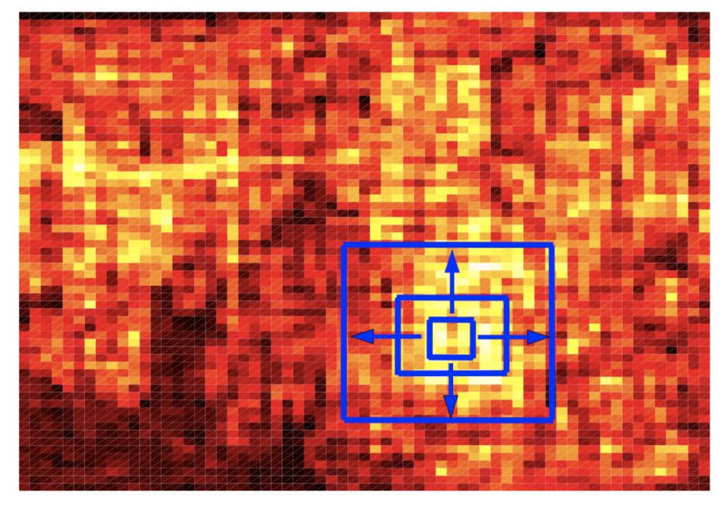
Introduction
Global routing solutions history
1990
Typical solution pipeline (Wong et al. 1990):
Net ordering
Multipin Decomposition
Solve Two-pin problem
Heuristics
Minimum Spanning Tree
A* Search
2007
Advanced Heuristics:
- Box Router (Cho et al. 2007)
Weakness:
- Rely on greedy algorithms
- Heuristics not generalizable
Box router congestion map and initial routing box
2019
Deep Reinforcement Learning Router
[1] Wong, C. C. M. S. C. (1990). IEEE Trans. Comput. Aided Des, 9, 1315-1325.
4
[2] Cho, M., & Pan, D. Z. (2007). IEEE Transactions on Computer-Aided Design of Integrated Circuits and Systems, 26(12), 2130-2143.
Notes:
Owing to its importance in the IC design flow, global routing has been one of the most active researched area in IC design for decades. In existing methods, an earlier typical solution pipeline consists of 3 steps, firstly, the nets to be routed are sequenced with an order; in routing individual nets in that sequence, there are usually more than two pins to be connected for each net, thus, multipin decomposition is used to decompose multipin problems into set of two pin problems. Finally, in solving for each two-pin problems, algorithms such as A* search are used.
Based on such basic solution pipelines, more advanced heuristics-based methods are later developed, such as adaptive routing method: the so-called Box Router. The figure here shows how Box Router, depends on congestion map, routing high congestion area first, and incrementally expand the box.
The weakness of existing global routing algorithms is obvious, firstly, they rely on greedy algorithms, which is not suitable for solving sequential problem. Secondly, heuristics methods are usually applicable with strong constraints, which makes it not generalizable.
Based on these works, we proposed a novel Deep Reinforcement Learning, or DRL router to solve global routing.

Slide 6
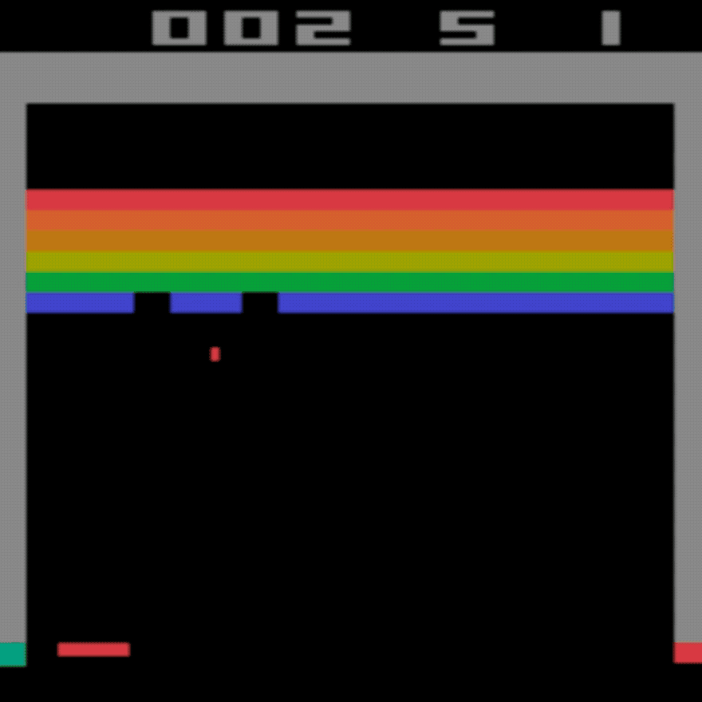
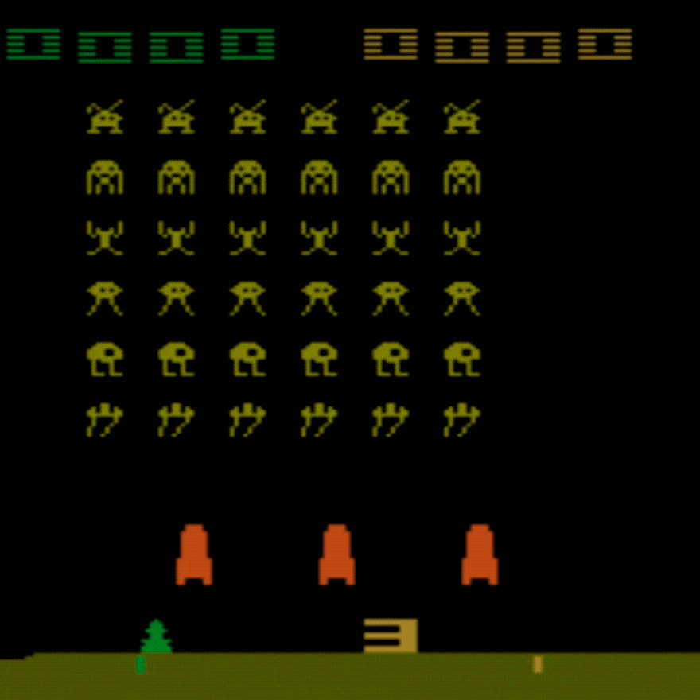
Introduction
Deep Reinforcement Learning (Mnih et al. 2013)
DRL plays Breakout and Space Invaders on an “above human” level
https://towardsdatascience.com/atari-reinforcement-learning-in-depth-part-1-ddqn-ceaa762a546f
5
Notes:
In recent years, DRL has demonstrated human-level ability to solve problems in simulated environment, such as playing Atari games. As shown here, a well-trained DRL agent can play games like Breakout and Space Invaders on an “above human” level.

Slide 7
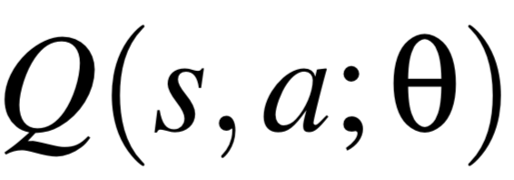
Introduction
DRL algorithm breakdown and motivation for using DRL
Deep Reinforcement Learning: reinforcement learning + deep learning
Reinforcement Learning (Sutton and Barto 2018)
Task: learning what to do
Key elements: action, state, reward
Optimal action-value function:
Function Approximator
Motivation for using DRL:
1. Global Routing can be modelled as a Markov Decision Process
2. DRL model is heuristics-free
3. DRL model has conjoint optimization mechanism
Use Deep Neural Networks
DRL
Network: Deep Q-network (DQN)
Sutton, R. S., & Barto, A. G. (2018). Reinforcement learning: An introduction. MIT press.
6
Notes:
DRL is essentially a combination of reinforcement learning and deep learning.
Reinforcement learning is learning what to do-that is, how to map situations to actions-so as to maximize a numerical reward signal.
And the key elements in a RL model consists of: action, state and reward.
At the heart of the value based DRL algorithm is the discovery of the optimal action-value function Q star, or Q function, which obeys the Bellman equation. From the Q function, you will have a state-to-action configuration, which means you know what action to take at certain sate.
In actual implementation, a function approximator is used to estimate the Q function, which is usually a linear function in Reinforcement Learning.
When we use deep neural networks as the function approximator, we call the algorithm deep reinforcement learning, or DRL, and the network used is referred to as the Deep Q-network (or DQN).
So why did we use DRL, and DQN to be specific to tackle the global routing problem? Firstly, global routing problems can be modelled as a Markov Decision Process, which is suitable for DRL; secondly, DRL model is heuristic free, and also during the exploration of DRL, we found that it has an amazing conjoint optimization mechanism in solving global routing.

Slide 8
Methods
Algorithm Overview
Problem Sets Generator
x
Two-pin 1
x
Problem file
x
x
Two-pin 2
File parsing
x
x
x
x
Multipin Decomposition
Two-pin 3
Multi-pins in one net
A set of two-pins
A* Search Router
DQN Router
Experience
Net 2 solution
x
Net 2 solution
x
x
x
x
x
Net 1 solution
A* search solution
DQN solution
Net 1 solution
x
x
x
x
x
x
Solution Evaluation
A* Solution
DRL Solution
7
Notes:
The flowchart shows our DQN-based approach to global routing problem.
Firstly, the input file is read in and parsed. Then each net is further decomposed into a set of two-pin problems with the Minimum Spanning Tree, as shown on the schematic plots on the right. A two-pin problems is to find wiring path for only two pins.
A* router and DQN router are then applied to solve all the two-pin problems sequentially; A* router is executed first to provide experience for the DQN solver. After final solution is obtained, the solution is evaluated in terms of WL and OF.

Slide 9
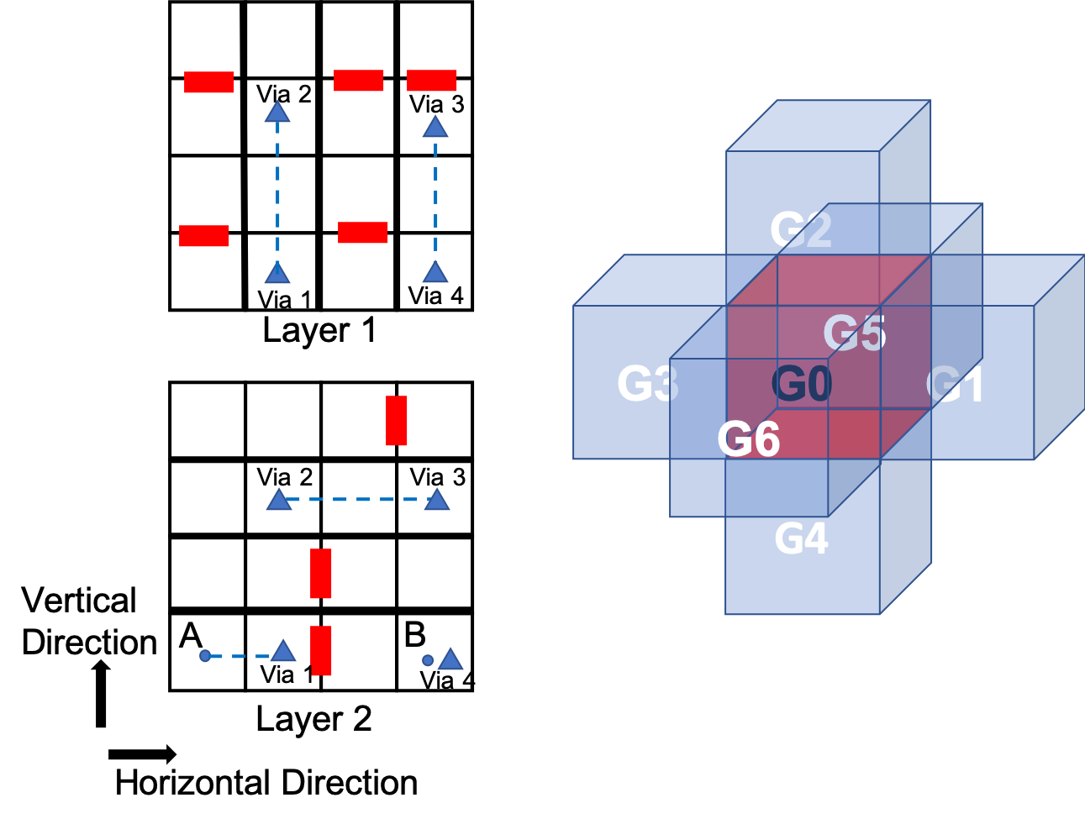
Methods
Via
Blocked edges
Simulated environment
Layer 1
x
Via
x
Layer 2
Choice of action at G0:
G1 (East)
G2 (Up)
G3 (West)
G4 (Down)
G5 (North)
G6 (South)
Illustration of simulated environment
https://www.google.com/search?q=chip&source=lnms&tbm=isch&sa=X&ved=0ahUKEwjAl_Wm6qXkAhXiRt8KHb2kDfMQ_AUIEigC&biw=1680&bih=845&dpr=2#imgrc=5HUyeISyc1Eg7M:
8
Notes:
In order to run our algorithm, a simulated environment is created. The figure schematically plots a simulated 4-by-4 two-layer global routing problem (which is an area on the chip), layer 1 is laid our layer 2; with bold edges and red block edges blocked. A two-pin problem is like finding a shortest path between point A and B.
Gcells on same position but on different layers could be connected with a via, as shown here.
As shown in the figure on the right, in DQN router, if an agent is standing at a certain Gcell, the potential action could be moving to one of the six directions (that is going east, west, north, south, up and down), which is subjected to boundary condition and capacity constraints in implementation. And for DQN router, the algorithm essentially learns what action to take at each Gcell by learning Q function.
(4by4by2, legend)

Slide 10
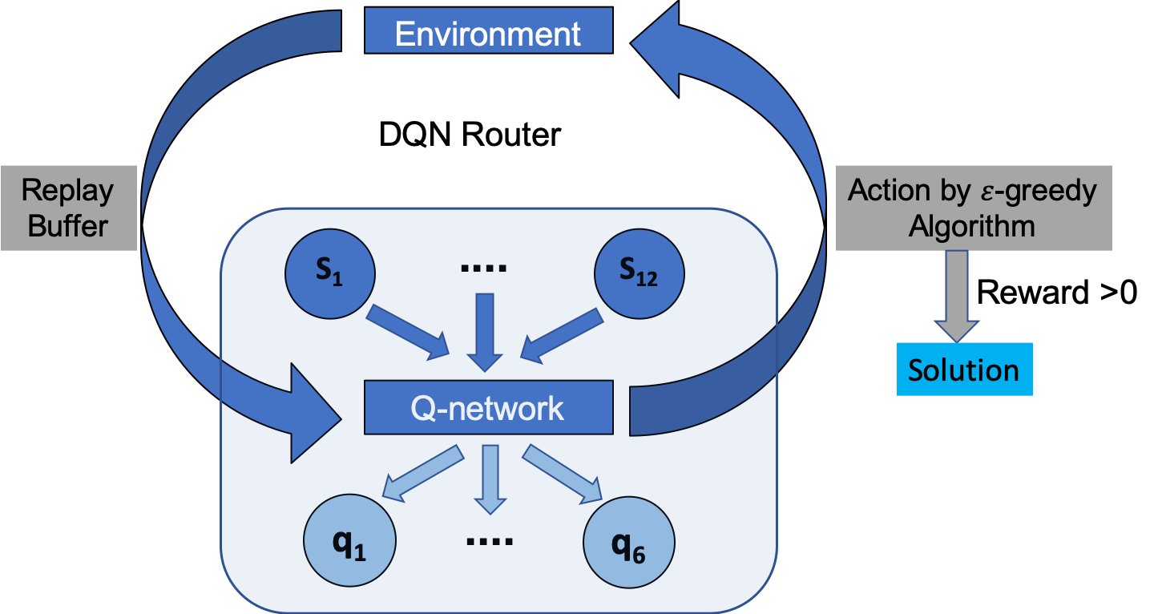
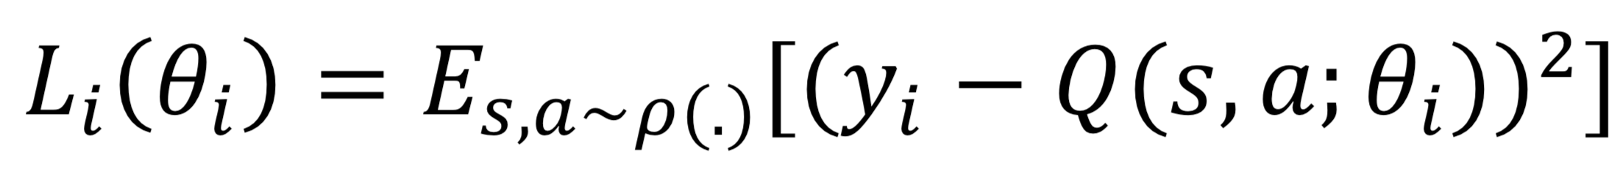
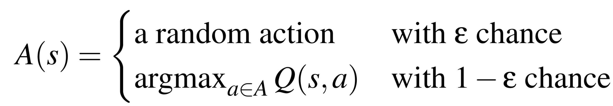
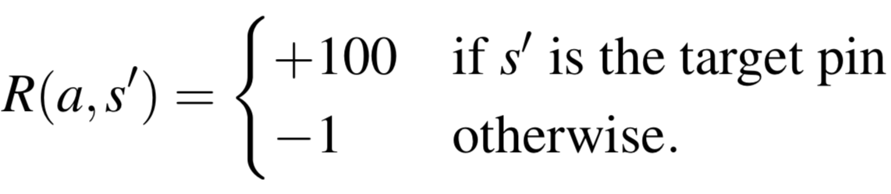

Methods
Transition: (s, a, s’, r)
DQN router
Training Q-network by minimizing loss function:
Optimizer: Adam
Framework: Tensorflow
Machine: Workstation with Intel Core i7
$ε$-greedy Algorithm:
Reward Design:
Termination Condition:
- Max Step Reached
- Target Pin Reached
9
Notes:
Then, let’s focus on the DQN router part.
When running the DQN router, the environment provides the network with state information.
Based on the output of Q-network, an epsilon-greedy algorithm is used to choose an action and execute in the environment. Epsilon-greedy algorithm can be described as taking action that maximize q values most of the time, while taking a random action occasionally.
The reward consists of only two parts, a positive 100 reward if goal is reached, and a negative one reward to penalize a normal walk. Termination consist of max step number reached or target pin reached.
In parallel, a replay buffer records each transition along the training process, which include current state s, current action a, next states s’, and reward r. A burn-in preprocess is used to fill in the replay buffer with experience before training begins, which in this work based on A* router’s solution. These transitions are used for backpropagation when iteratively optimizing the Q-network. The network is trained until all two pin problems are solved, and a single passage of the entire set of two-pin problems are called an episode.
In training the Q-network, the loss function is shown here, which is the expectation of squared error between Q-values from Q network and target Q values, denoted as yi. Here, yi is obtained from the Bellman equation form. By differentiating the loss with respect to network weights, the gradient can be obtained which is used to optimize Q network weights. The networks is realized with Tensorflow framework, optimized with Adam optimizer and ran on a workstation with Intel Core i7.
Eploration-exploitation: depth – width of search

Slide 11
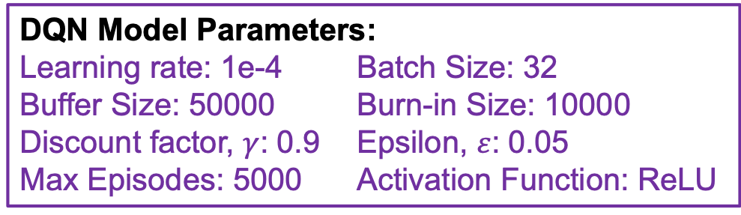
Methods
Optimized parameters and network structures
64
Input
Output
32
32
DQN Model Parameters:
Learning rate: 1e-4 Batch Size: 32
Buffer Size: 50000 Burn-in Size: 10000
Discount factor, $γ$: 0.9 Epsilon, $ε$: 0.05
Max Episodes: 5000 Activation Function: ReLU
…………
………..……
…………
……
……
_{s}
h₁
h₂
h₃
_{q}
10
Notes:
Based on model fine tuning, optimized parameters including learning rate, buffer size, gamma and epsilon, etc. are listed here. The optimized Q-network structure, as shown in the figure, consists of three-layer fully connected networks with ReLU as activation function for each layer.

Slide 12
Results and Discussion
Define two types of problems
Type I Problem (no-edge-depletion problem)
Feature: no edge that originally has a positive capacity is fully utilized (goes to zero) based on A* route
Type II Problem (partial-edge-depletion problem)
Feature: at least some edges that originally have a positive capacity are fully utilized (goes to zero) based on A* route
After routes
After routes
Original Capacity
Remaining Capacity
Original Capacity
Remaining Capacity
11
Notes:
A classification of routing problem is done first before we demonstrate results. Based on the A* routing solution, we define two categories of routing problems.
As shown in the figure, the capacity condition is schematically illustrated by capacity map. The number in each grid denotes the capacity of an edge in that position along certain direction. Although, there are edges of multiple directions at each location, for simplicity, we only represent the capacity for each problem with one capacity map.
For Type I problem, or no-edge-depletion problem, the feature is that no edge that originally has a positive capacity is fully utilized (or goes to zero) after route. Depletion here just means the edge capacity goes to zero.
For type II problem, or partial-edge-depletion problem, the feature is that at least some edges that originally have a positive capacity are fully utilized (goes to zero) after route.

Slide 13
Results and Discussion
Explain the performance difference of A* and DQN router
Threshold at 0
Original Capacity before route
Remaining
Capacity after route
(Type I Problem)
Remaining
Capacity after route
(Type II Problem)
Capacity Map
Binarized Capacity Map
12
Notes:
Based on the experimental results, we found that under appropriate model parameters, DQN router performs overwhelmingly better than the baseline A* router in Type II problem, but not in Type I problem.
To explain the overwhelming better performance of DQN in Type II problem, we analyzed the conjoint optimization mechanism of DQN, firstly let’s look at the capacity maps and their binarized version, which is essentially capacity map thresholds at zero, we call it binarized capacity map.
For a Type I problem, since no edge that originally has positive capacity, is fully utilized or goes to zero throughout the routing process, the binarized capacity map would not change. However, when solving for a Type II problem, the binarized capacity map would start changing at certain stage along the routing process.

Slide 14
Results and Discussion
Explain the performance difference of A* and DQN router
A*
DQN
Find solution based on binarized capacity maps
Guarantee optimum solution for Type I problem
Perform poorly in Type II problem under inappropriate
problem sequence
A* Succeeds in Type I
Guided by reward and state representation
Experience from solving all two-pin problems
Experience encoded in a single Q-network
A
X
√
A
B
A* Fails in Type II
B
A
X
Conjoint Optimization Mechanism
B
13
Notes:
When using A* search, it only matters if a certain edge is positive or not, which means that A* essentially finds the solutions based on the binarized capacity maps. Since the binarized capacity maps does not change throughout routing in a Type I problem, the sequence for routing those two pin problems does not matters anymore. A* with admissible heuristics can guarantee optimum solutions for each two-pin problem, therefore it can also guarantee an optimum solution for a whole Type I problem.
As mentioned in the last slides, when solving for a Type II problem in which the binarized capacity map, starts to change after some two-pin problems have been routed, A* would no longer be able to provide global optimum or even a good solution, since it cannot taken into account all the two-pin problems to be routed together, instead it’s only solving each two-pin problems in a greedy manner. Under inappropriate sequence of two-pin problems, A* would probably fail in solving Type II problem.
As shown in the illustrated example, in a Type I case, A* can still connect point A and B utilizing the remaining capacity shown in the previous slides; yet, in a Type II case, it would fail because nets already routed has used too much capacity.
For DQN router, it is guided by reward signal and state representation, and getting experience when solving all two-pin problem iteratively. In such way, DQN router is able to solve all two-pin problems conjointly with a single Q-network encoding all the past experience in a heuristic free manner. It would therefore try to avoid the bad condition like the one in A* to happen by taken into account all two-pin problems. And we call such mechanism, the “Conjoint Optimization Mechanism” of DQN router.

Slide 15
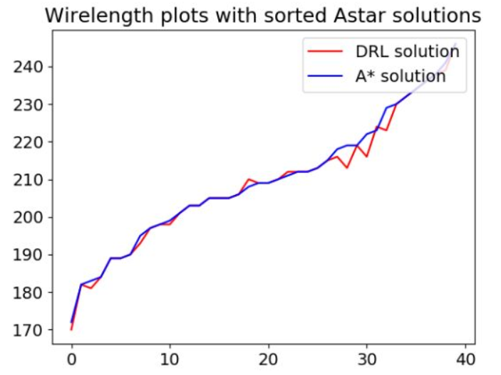
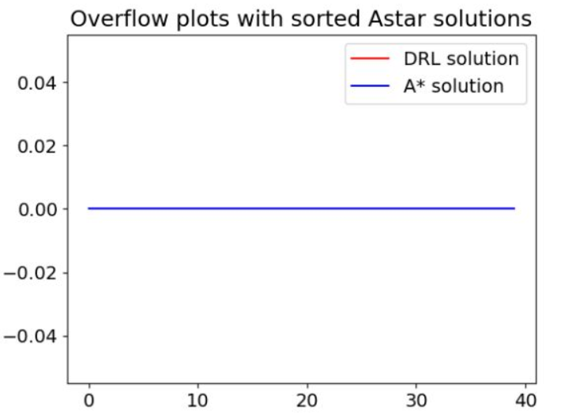
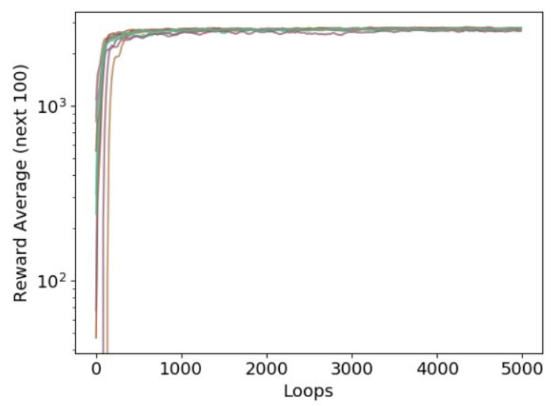
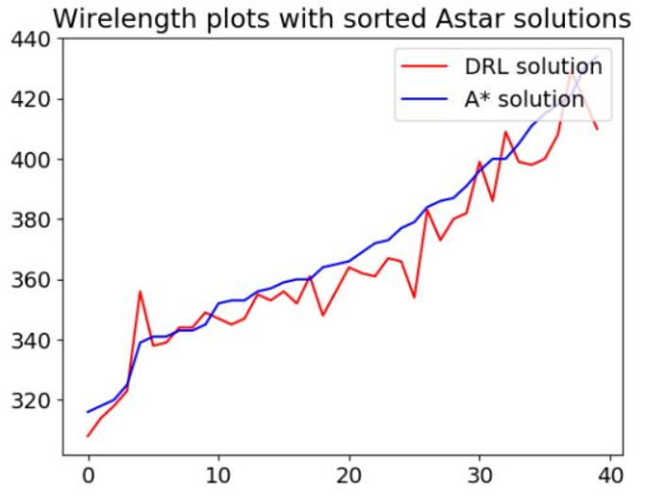
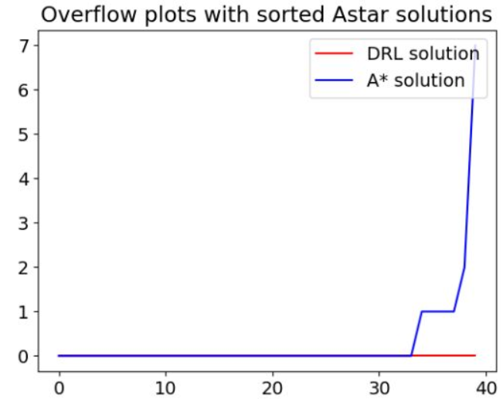
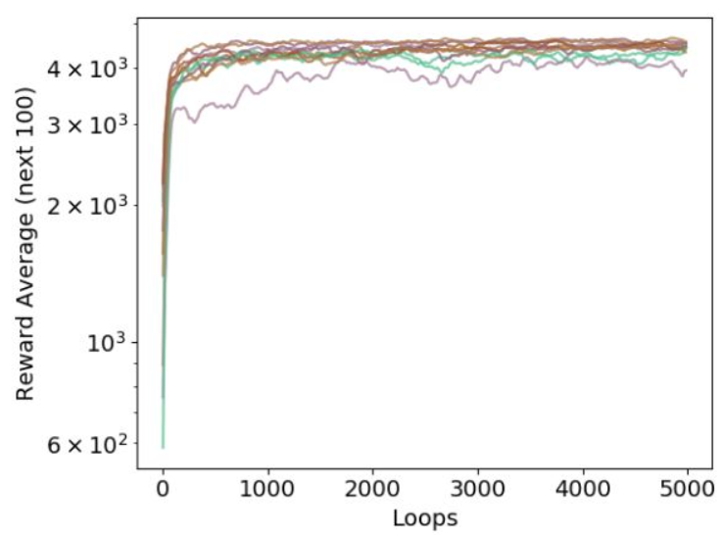
Results and Discussion
Experiments shows that DRL performs better than A* in Type II problem
Wirelength
Overflow
Reward Log Plot of DQN Router
Type I
Problem
Two lines overlap
DRL win rate: 22.5%
Problem Index
Problem Index
Episodes
Type II
Problem
Oscillations at high reward
DRL win rate: 80%
Problem Index
Problem Index
Episodes
14
Notes:
Type I and Type II problem are simulated with experiments to show DQN router’s different performance in Type I and Type II problem. In these plots, Y-axis corresponds to WL or OF values, and X-axis are just problem index based on sorted WL or OF. In evaluating the solution, the smaller the value of WL or OF is, the better the solution is.
By comparing of WL and OF results in different types of problem, which is on the first and second column. It is obvious that DQN model performs overwhelmingly better in Type II problem, while in Type I problem, there is no obvious advantage compared with baseline A* router.
The log plots of learning curves of 10 randomly selected cases (which is log value of reward vs. number of episodes) indicate that in solving Type I problem, there is limited oscillations in learning curves after high reward achieved, while in solving for type II problem, the reward curves keep oscillating even after high reward achieved, which indicates more active adjustment of network weights to realize the conjoint optimization mechanism.

Slide 16
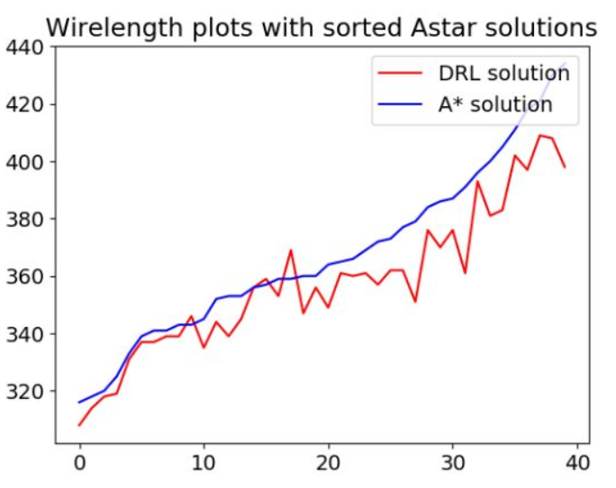
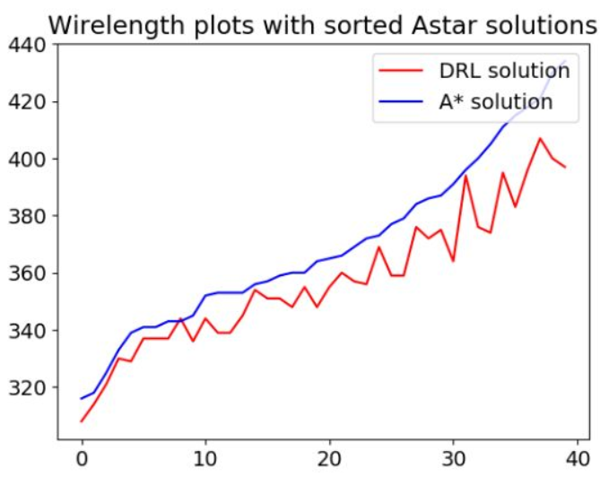
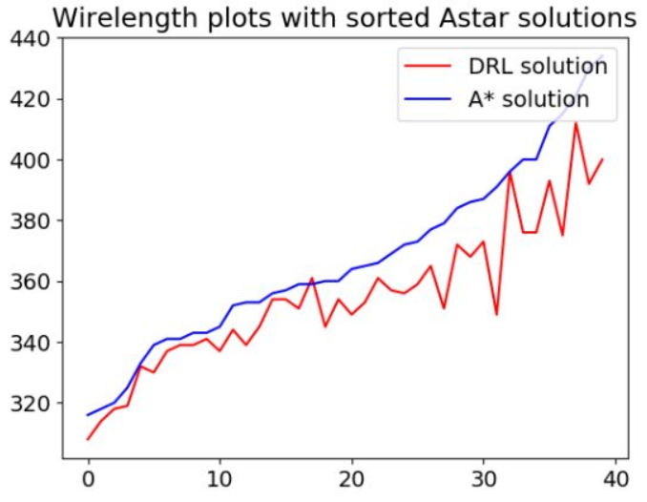
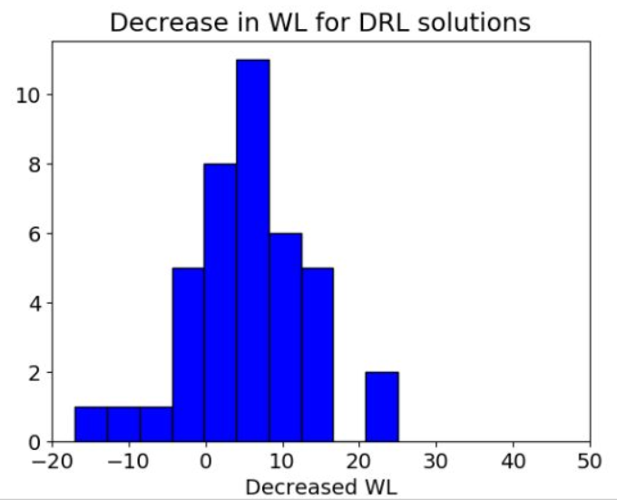
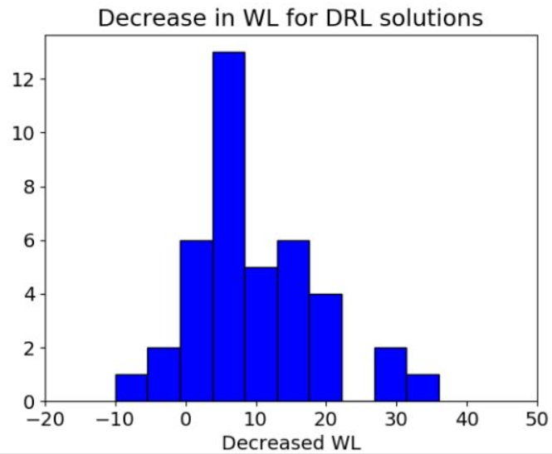
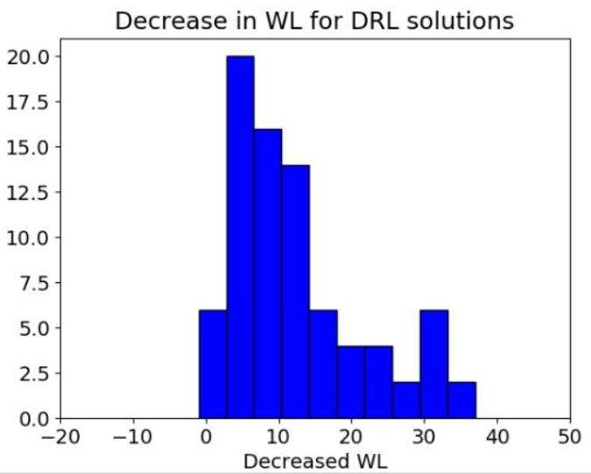
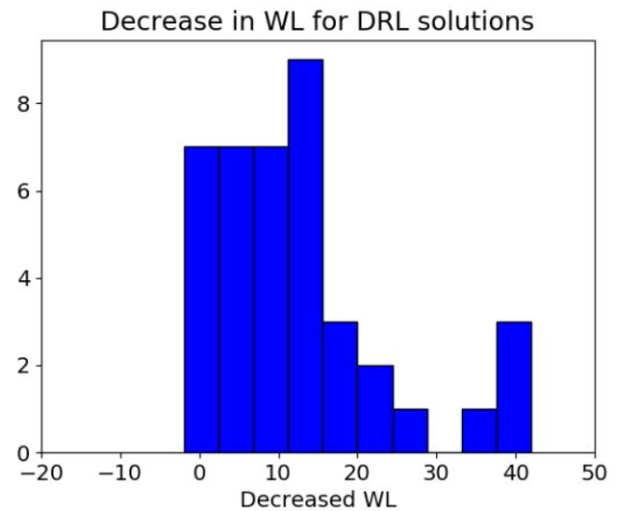
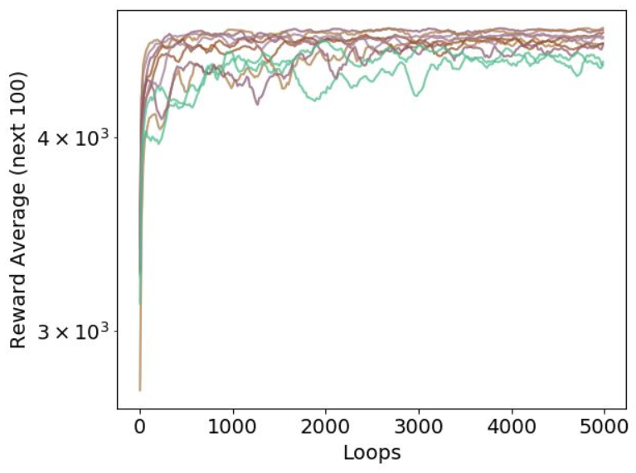
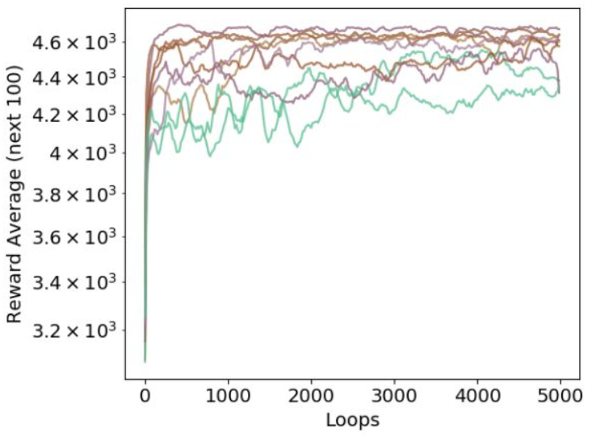
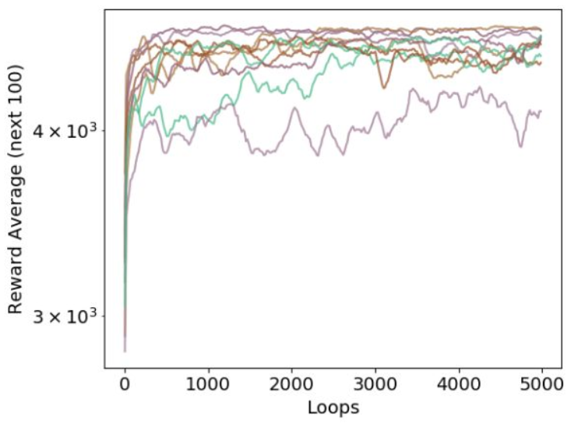
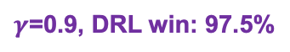

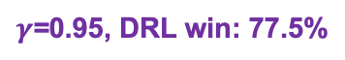
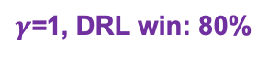
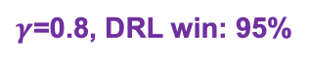
Results and Discussion
Discount factor tuning
Best $γ$
$γ$=1, DRL win: 80%
$γ$=0.95, DRL win: 77.5%
$γ$=0.9, DRL win: 97.5%
$γ$=0.8, DRL win: 95%
Wirelength Plot
WL Decrease
Reward Log Plot
Episodes
Episodes
Episodes
Episodes
15
Notes:
After understanding the working mechanism of DQN router, we did some performance improvement fine tuning of the model. The most important one if the tuning of discount factor, gamma.
The plots show WL results for models with different gamma values, and their comparison to baseline A* solutions on 40 problems. In all cases, DRL performs overwhelmingly better, and the best one is achieved when gamma is 0.9. In such case, as shown in the histogram of WL decrease of DRL solution compared with A* solution, the decreases are almost all non-negative, which is really good. By comparing the Reward Log Plot under different gamma values, it can be found that the smaller the gamma value is, the greater the oscillations of reward curve.

Slide 17
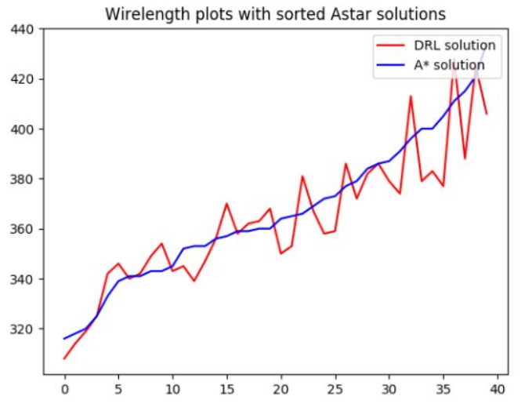
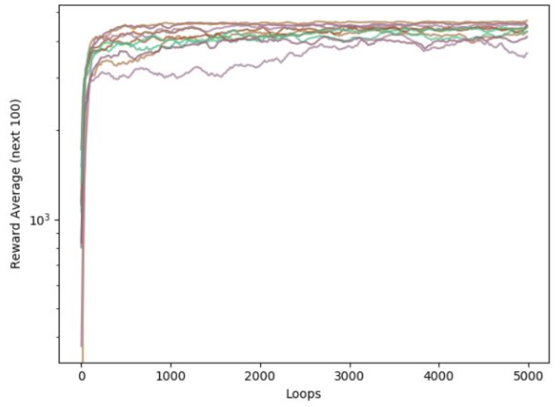
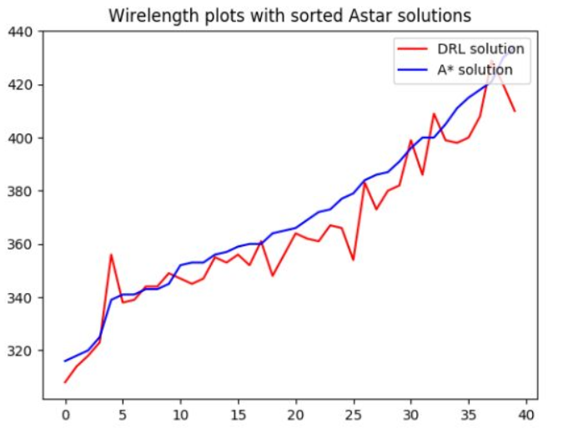
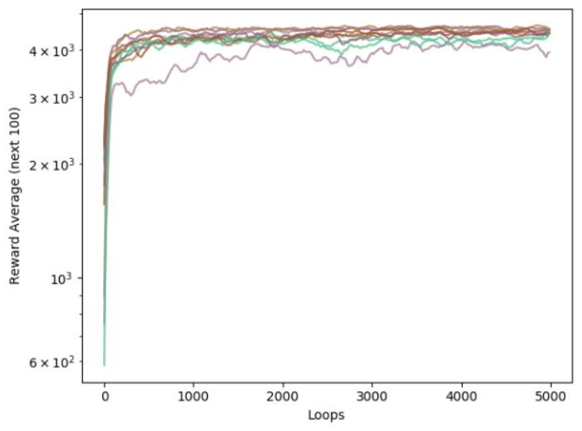
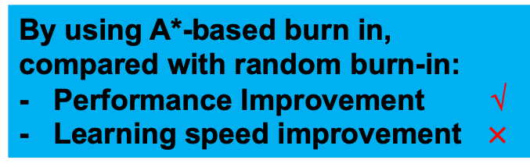
Results and Discussion
Burn-in Memory Choice: A*-based burn in memory better
WL comparison
Reward Log Plot
DRL win: 50%
Random Burn-in Memory
By using A*-based burn in, compared with random burn-in:
- Performance Improvement √
- Learning speed improvement $×$
Episodes
DRL win: 80%
A*-based Burn-in Memory
Episodes
16
Notes:
We also looked at the choice of burn-in memory, by comparing the performance of a random burn-in memory, which is experience obtained by random walk in the environment, versus burn-in memory based on A* search solutions, it is obvious that A*-solution based burn-in memory could significantly improve the final performance of DQN router, yet the learning speed improvement with the introduction of A* burn-in memory is negligible, as shown in the reward log plot.

Slide 18
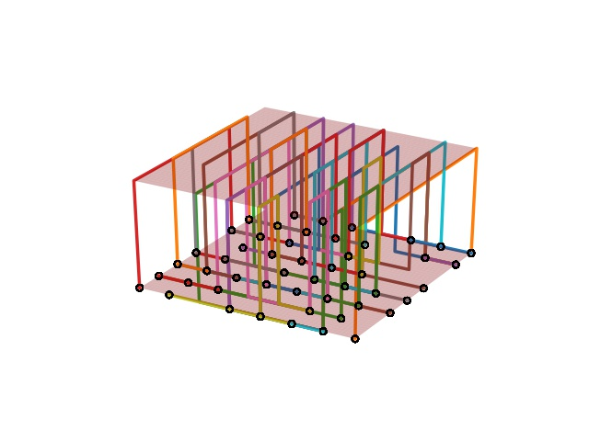
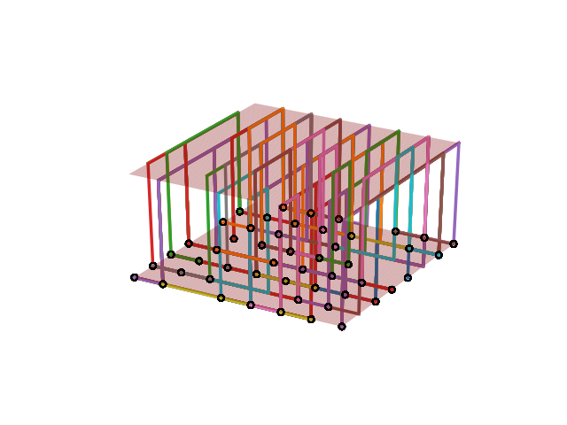
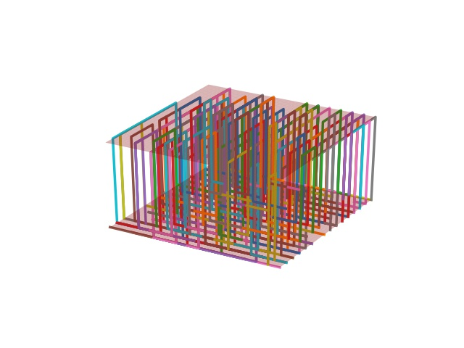
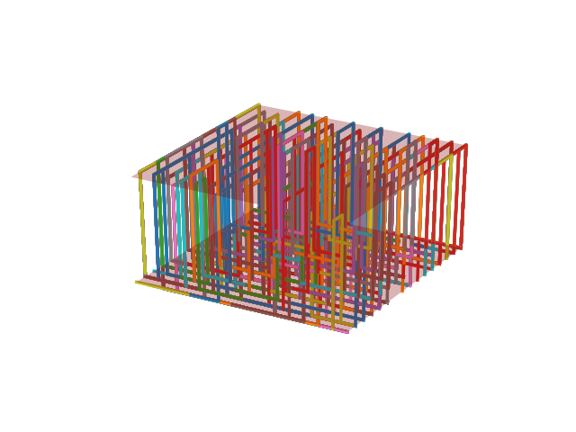
Results and Discussion
Visualized Route Results
8*8 Problem
A* Route
WL: 353, OF: 0
DQN Route
WL: 339, OF: 0
16*16 Problem
A* Route
WL: 1900, OF: 0
DQN Route
WL: 1898, OF: 0
17
Notes:
Finally, we demonstrate the visualized results of DQN and A* router’s solution on 8*8 and 16*16 problems. DQN model is trained based on 8*8 and directly applied to solve 16*16 problem without changing model parameters or structures and is still able to achieve superior performance compared with A* router. However, detailed analysis in the model’s ability to scale up is part of our future work.

Slide 19
Limitations
Limited ability to scale up DQN model
Performance improvement of DQN compared with baseline limited
Full-fledged parametric study needed to understand interactive effects of different model parameters
18
Notes:
Before or after conclusions?

Slide 20
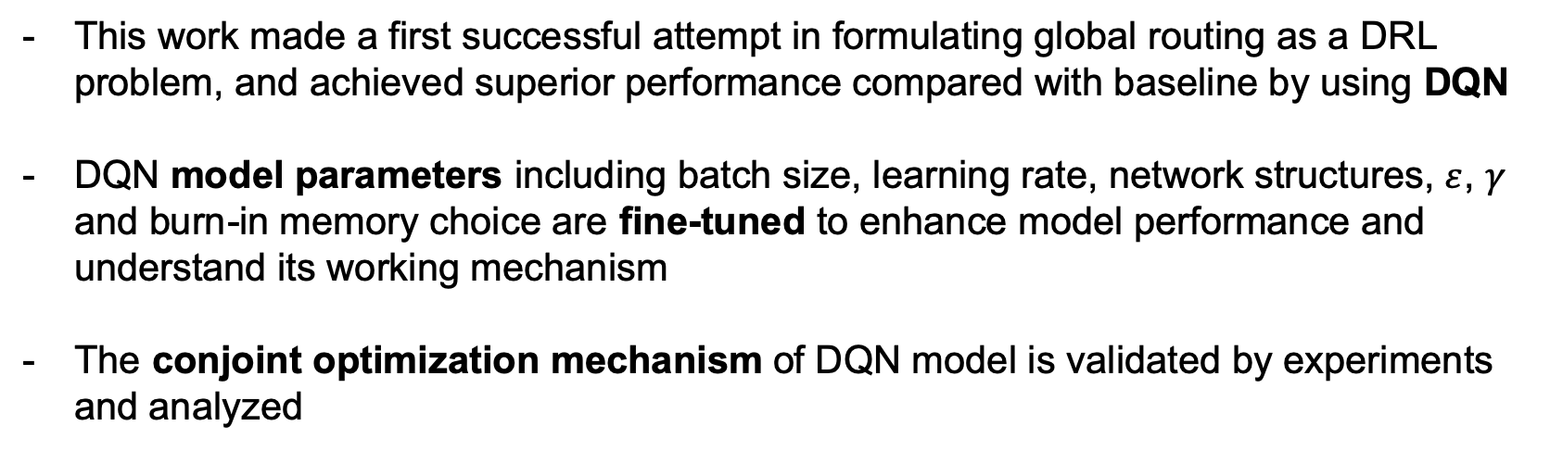
Conclusions
This work made a first successful attempt in formulating global routing as a DRL problem, and achieved superior performance compared with baseline by using DQN
DQN model parameters including batch size, learning rate, network structures, $ε$, $γ$ and burn-in memory choice are fine-tuned to enhance model performance and understand its working mechanism
The conjoint optimization mechanism of DQN model is validated by experiments and analyzed
19
Notes:
Let’s briefly summarize the main conclusions of this research: This work made a first successful attempt in formulating global routing as a DRL problem, and achieved superior performance compared with baseline, by using a classical DRL model – DQN
DQN model parameters including batch size, learning rate, network structures, epsilon, gamma and burn-in memory choice are fine-tuned to enhance model performance and understand its working mechanism
The conjoint optimization mechanism of DQN model is validated by experiments and analyzed

Slide 21
Thank you!
20
Notes:
Finally, I would like to acknowledge our funding agency and collaborators. Thank you!

Slide 22
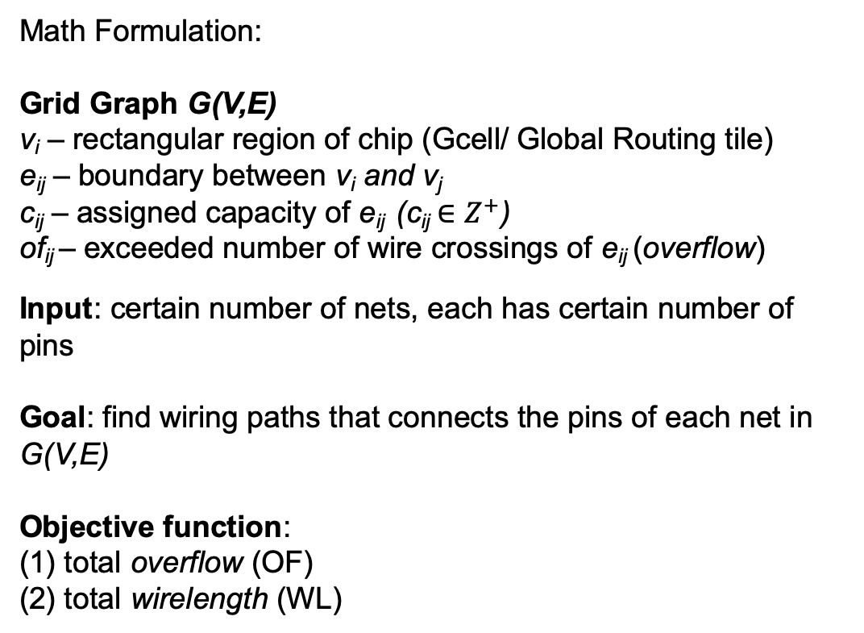
Backup Slides – Specific Math Formulation of Graph problem
Math Formulation:
Grid Graph G(V,E)
v_{i} – rectangular region of chip (Gcell/ Global Routing tile)
e_{ij} – boundary between v_{i} and v_{j}
c_{ij} – assigned capacity of e_{ij} (c_{ij}$∈Z^{+}$)
of_{ij} – exceeded number of wire crossings of e_{ij} (overflow)
Input: certain number of nets, each has certain number of pins
Goal: find wiring paths that connects the pins of each net in G(V,E)
Objective function:
(1) total overflow (OF)
(2) total wirelength (WL)

Slide 23
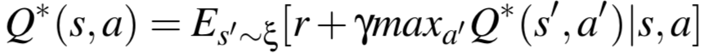
Backup Slides – Introduction DRL details
The goal of this work is to formulate and solve global routing as a DRL problem, and analyze why it works well
Deep Reinforcement Learning: reinforcement learning + deep learning
Reinforcement Learning [1]
Task: learning what to do
Key elements: action, state, reward
Optimal action-value function:
Motivation for using DRL: - Global Routing can be modelled as a MDP
DRL model is heuristics-free
DRL model has conjoint optimization mechanism
Bellman Equation:
Obey
Function Approximator
DRL
Network: Deep Q-network (DQN)
Use Deep Neural Networks
[1] Sutton, R. S., & Barto, A. G. (2018). Reinforcement learning: An introduction. MIT press.
Notes:
In order to develop better global routing solutions or routers, we formulated the global routing problem as a Deep Reinforcement Learning problem. In recent years, DRL has demonstrated human-level ability to solve problems in simulate environment, such as playing Atari games.
Let me briefly go through some key concepts and equations of DRL. DRL is essentially a combination of reinforcement learning and deep learning.
-Reinforcement learning is learning what to do-that is, how to map situations to actions-so as to maximize a numerical reward signal. The most important two features of RL is trials-and-error search and delayed reward
And the key elements in a RL model consists of: action, state and reward.
At the heart of the value based DRL algorithm is the discovery of the optimal action-value function Q star, or Q function, by maximizing the expected return starting from state s, taking action a and then following a policy pi. From the Q function, you will have a state-to-action configuration.
The optimal action-value function obeys the Bellman equation, and many RL algorithm estimate the action-value function in an iterative manner, which converges to the optimal action-value function. In the Bellman equation, the Q-function is the expectation of current reward and maximized future reward multiplied with a discount factor gamma, given a state and an action taken from that state. In actual implementation, a function approximator Q(s,a;thea) is used to estimate the optimal action-value function. When we use deep neural networks as the function approximator, we call the algorithm deep reinforcement learning, and the network used is referred to as the Deep Q-network (or DQN).
So why did we use DRL to tackle the global routing problem? Firstly, global routing, especially the two-pin problems can be modelled as a Markov Decision Process, then DRL model is heuristic free and during the exploration of DRL, we found that it has an amazing conjoint optimization mechanism in solving global routing.

Slide 24
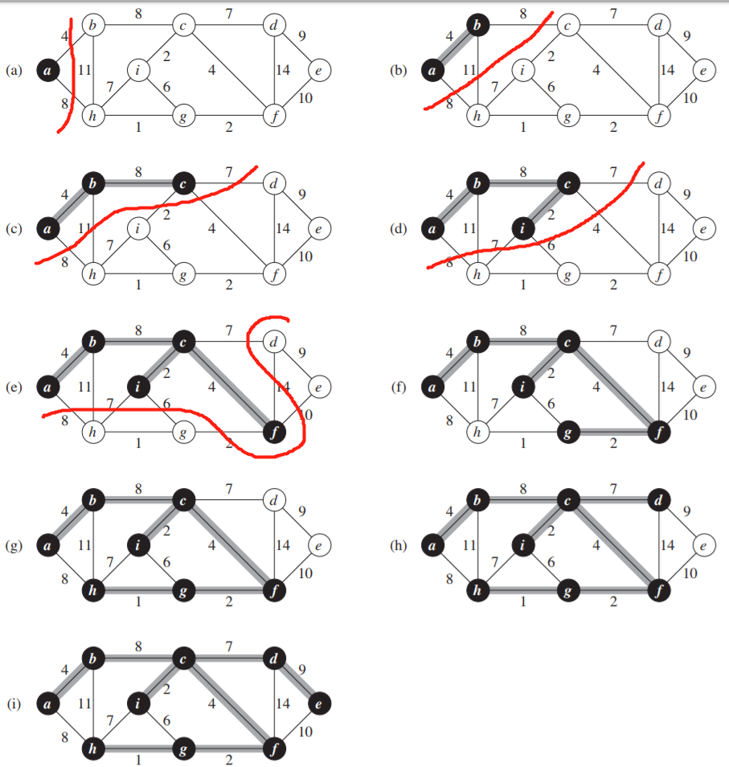
Backup Slides – Minimum Spanning Tree (PRIM)
The safe edge added to a is always a least-weight edge connecting the tree to a vertex not in the tree.
The tree starts from an arbitrary root vertex r and grows until the tree spans all the vertices in V
At each step of the algorithm, the vertices in the tree determine a cut of the graph, and a light edge crossing the cut is added to the tree.
Cormen, T. H., Leiserson, C. E., Rivest, R. L., & Stein, C. (2009). Introduction to algorithms. MIT press.

Slide 25
Backup Slides – A* Search
Define total cost: f(n) = g(n) + h(n)
g(n) → path cost from S to n
h(n) → estimated cost of the cheapest path from n to G.
What property must h(n) have for A* to be optimal?
h(n) must be an admissible heuristic.
h(n) <= h*(n)
h(n) should never overestimate the cost to get to G.s
Greedy: describe any search or decision procedure that selects alternatives based only on local or immediate considerations, without considering the possibility that such a selection may prevent future access to even better alternatives [1].
[1] Sutton, R. S., & Barto, A. G. (2018). Reinforcement learning: An introduction. MIT press.
Courtesy of Professor Kara Course Slides
Notes:
???

Slide 26
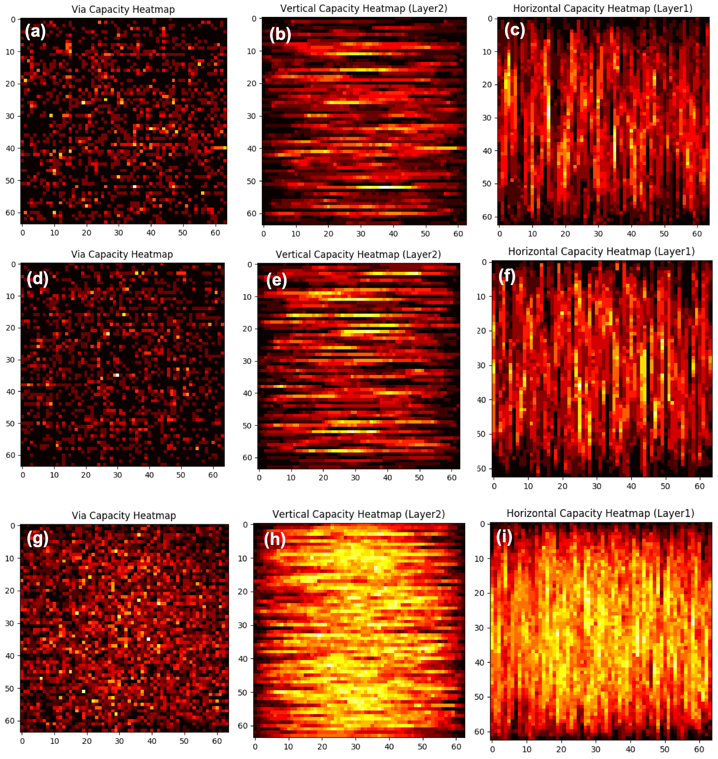
Backup Slides – Global Routing Problem Generator
Main Purpose of developing generator:
-Provide problems to compare routing algorithms with sets of similar problems
-Provide more generalizable DRL solver with enough problems for training
Variables:
Problem number
Grid size
Net numbers
Capacity (global)
Maximum pin numbers each net
Reduced capacity edge numbers
Notes:
???

Slide 27
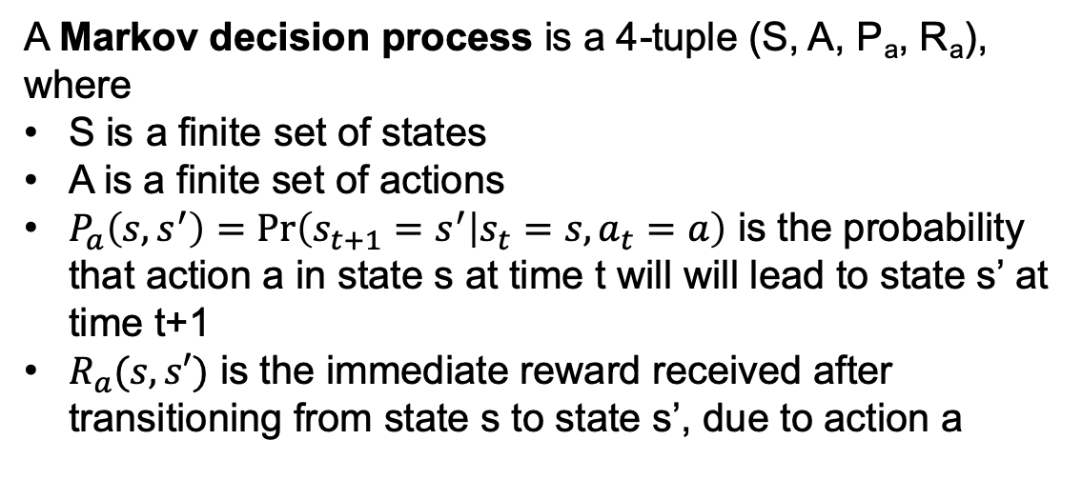
Backup Slides – Markov Decision Process (MDP)
A Markov decision process is a 4-tuple (S, A, P_{a}, R_{a}), where
S is a finite set of states
A is a finite set of actions
$P_{a}\left(s,s^{′}\right)=\operatorname{Pr}\left(s_{t+1}=s^{′} | s_{t}=s, a_{t}=a\right)$ is the probability that action a in state s at time t will will lead to state s’ at time t+1
$R_{a}(s,s′)$ is the immediate reward received after transitioning from state s to state s’, due to action a
https://en.wikipedia.org/wiki/Markov_decision_process
Notes:
Mathematically, MDP is defined by a 4 tuple, which include, S, A, P, and Ra. ….. Example of MDP could be: decide how much to invest in stock

Slide 28
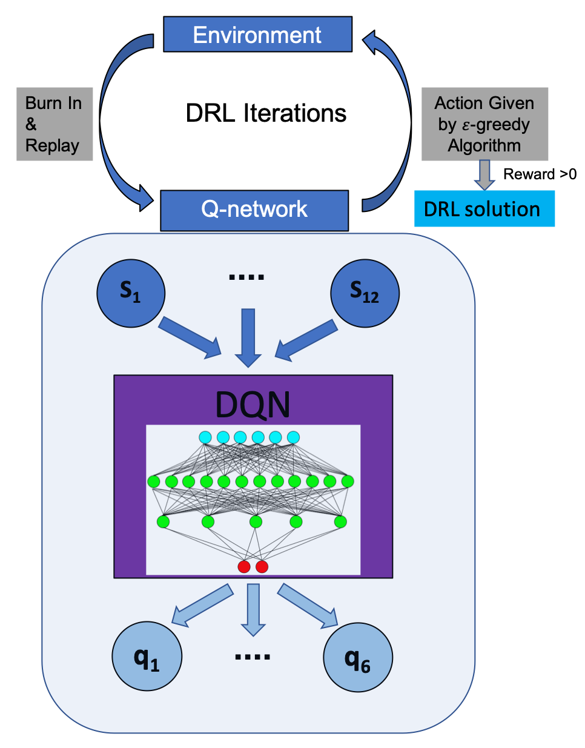
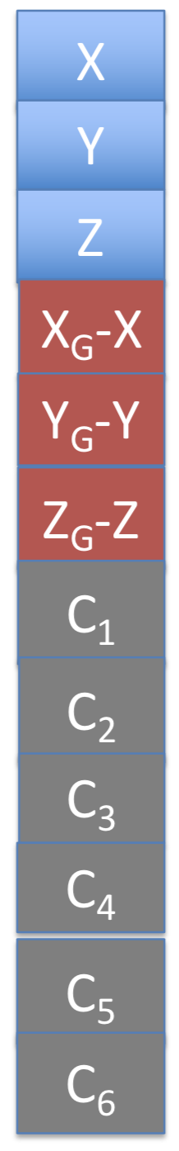
Backup Slides – State Representation
State Representation
DQN Router
Current Position
Distance to Goal
Neighboring Capacity

Slide 29
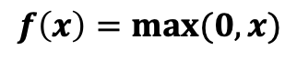
Backup Slides – Network Structures (Why ReLU)
Input
Output
ReLU (Rectified Linear Unit):
Advantage:
Better gradient propagation
Efficient computation
$$f\left(x\right)=max⁡(0,x)$$
…………
………..……
…………
……
……
x
h₁
h₂
h₃
_{O}

Slide 30
Backup Slides – Action Representation
Up (q₅)
North (q₃)
West (q₂)
East (q₁)
East (q₄)
Down (q₆)

Slide 31
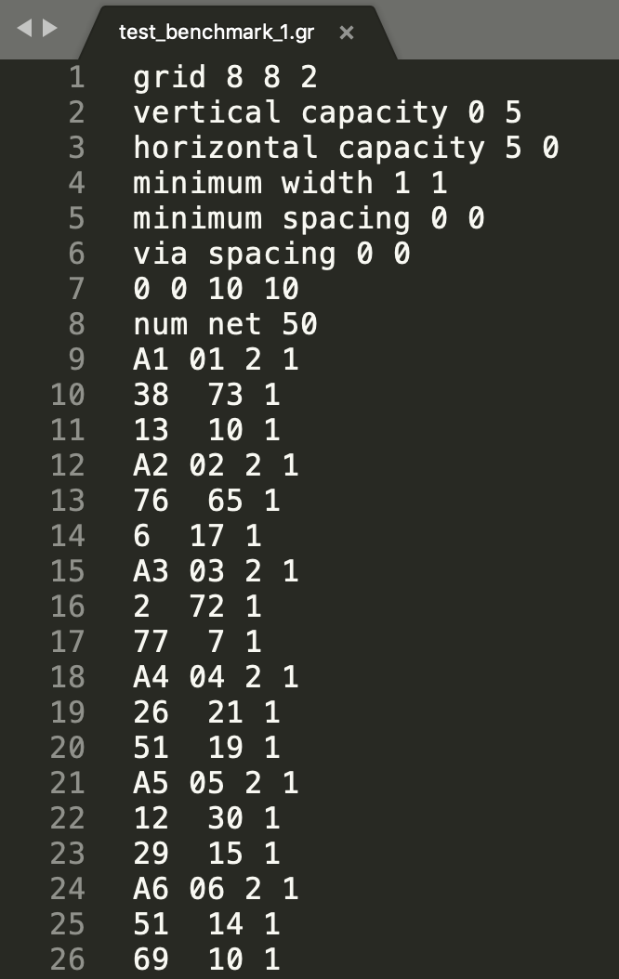
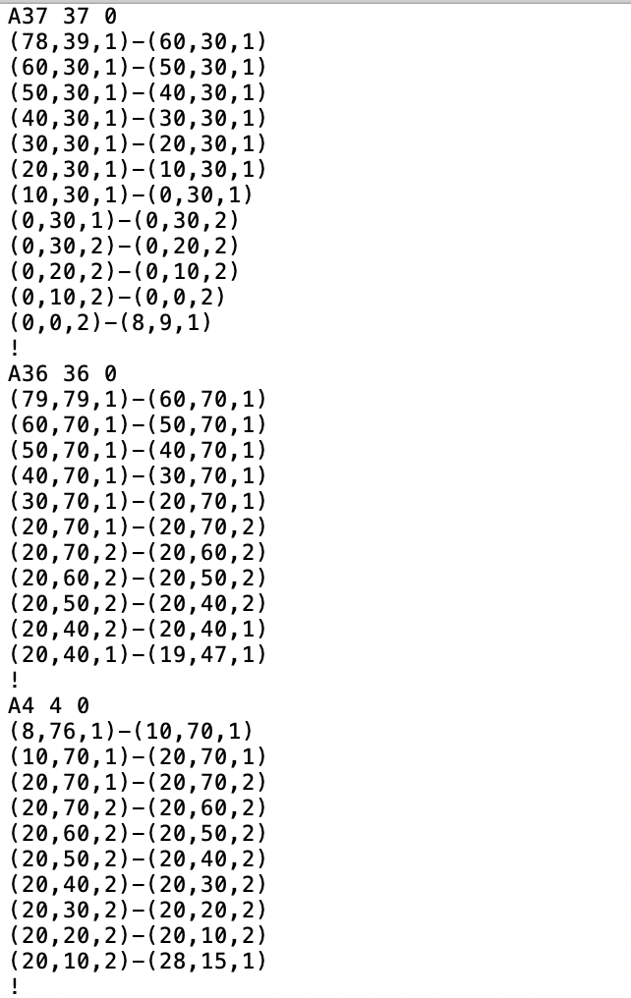
Backup Slides – I/O Files
Input File:
Output File:

Slide 32


Backup Slides – Optimizer Adam (Adaptive Moment Estimation)
First Moment:
Second Moment:
Bias-corrected First Moment:
$ε$: small scalar preventing division by 0
$β_{1}$, $β_{2}$: forget factors
Squaring and square-rooting is done elementwise
Bias-corrected Second Moment:
Update Parameters:
Advantage of Adam:
Straightforward to implement
Little memory requirements
Appropriate for problems with noisy gradients
Kingma, D. P., & Ba, J. (2014). Adam: A method for stochastic optimization. arXiv preprint arXiv:1412.6980.
https://en.wikipedia.org/wiki/Stochastic_gradient_descent#Adam
Notes:
???

Slide 33

Backup Slides – Key Experiments Parameters
Key Experiments Parameters showing problem parameters and model parameters
Problem Parameters
Model Parameters
Notes:
Here is a list of our key experiments parameters, which consists of problem parameters, which is realized by our in-house developed problem generator and model parameters, which includes, episodes, max step, gamma, epsilon, etc., which controls the behavior of models and trade-off between different goals.

Slide 34

Backup Slides – General Parameter Tuning
Optimized Value:
Batch size: 32
Learning rate: 1e-4
Epsilon: 0.05
Network: [32,64,32]

Slide 35






Backup Slides – Edge Utilization Plots
Experiments No. 8 – Type I problem edge utilization plots
Type I
Type II
Type I
Type I
Type II
Type I

